Slide 1
Applications of Grammar and Writing Improvement:
Text proofreading and error correction.
Style and tone enhancement.
Sentence rephrasing for clarity.
Grammarly

Slide 2
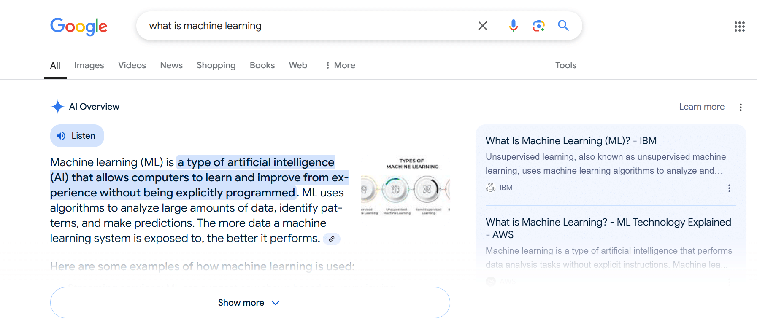
Applications of Search Engines:
AI-powered query refinement.
Personalized search results.
Enhanced information discovery.
Perplexity
Google AI Overviews

